Slide 1
Bootcamp_Data Engineering Training
Prepared By,
Srimathi Chandrasekaran
20/05/2022

Slide 2

Chapter1: BigData EcoSystem & Linux

Slide 3
Hive
Apache Hive is a data ware house system for Hadoop that runs SQL like queries called HQL (Hive query language) which gets internally converted to map reduce jobs.
Hive was developed by Facebook. It supports Data definition Language, Data Manipulation Language and user defined functions.
Features:
Hive is fast and scalable.
It provides SQL-like queries (i.e., HQL) that are implicitly transformed to MapReduce or Spark jobs.
It is capable of analyzing large datasets stored in HDFS.
It allows different storage types such as plain text, RCFile, and HBase.
It uses indexing to accelerate queries.
It can operate on compressed data stored in the Hadoop ecosystem.
It supports user-defined functions (UDFs) where user can provide its functionality.
Limitations of Hive
Hive is not capable of handling real-time data.
It is not designed for online transaction processing.
Hive queries contain high latency.

Slide 4
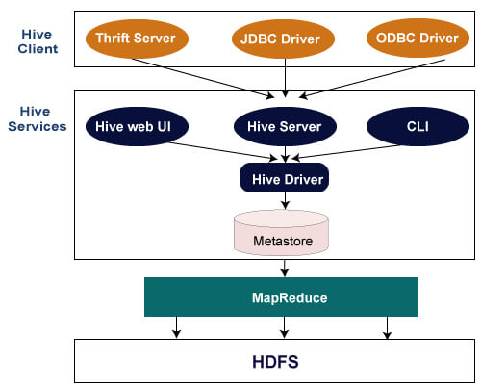
HIVE Architecture & Installation:
HIVE supports different types of clients such as:-
Thrift Server - It is a cross-language service provider platform that serves the request from all those programming languages that supports Thrift.
JDBC Driver - It is used to establish a connection between hive and Java applications. The JDBC Driver is present in the class org.apache.hadoop.hive.jdbc.HiveDriver.
ODBC Driver - It allows the applications that support the ODBC protocol to connect to Hive.

Slide 5
HIVE Data Types
Hive data types are categorized in numeric types, string types, misc types, and complex types.
Type | Size | Range
TINYINT | 1-byte signed integer | -128 to 127
SMALLINT | 2-byte signed integer | 32,768 to 32,767
INT | 4-byte signed integer | 2,147,483,648 to 2,147,483,647
BIGINT | 8-byte signed integer | -9,223,372,036,854,775,808 to 9,223,372,036,854,775,807
Type | Size | Range
FLOAT | 4-byte | Single precision floating point number
DOUBLE | 8-byte | Double precision floating point number

Slide 6
Date/Time Types
TIMESTAMP
It supports traditional UNIX timestamp with optional nanosecond precision.
As Integer numeric type, it is interpreted as UNIX timestamp in seconds.
As Floating point numeric type, it is interpreted as UNIX timestamp in seconds with decimal precision.
As string, it follows java.sql.Timestamp format "YYYY-MM-DD HH:MM:SS.fffffffff" (9 decimal place precision)
DATES
The Date value is used to specify a particular year, month and day, in the form YYYY--MM--DD. However, it didn't provide the time of the day. The range of Date type lies between 0000--01--01 to 9999--12--31.

Slide 7
Hive - Create & Drop Database
hive> create database demo;
hive> show databases;
hive>create the database demo
>WITH DBPROPERTIES ('creator' = 'Gaurav Chawla', 'date' = '2019-06-03');
hive> describe database extended demo;
hive> drop database demo;

Slide 8
Hive - Create Table
In Hive, we can create a table by using the conventions similar to the SQL. It supports a wide range of flexibility where the data files for tables are stored. It provides two types of table: -
Internal table
External table
Internal Table
The internal tables are also called managed tables as the lifecycle of their data is controlled by the Hive. By default, these tables are stored in a subdirectory under the directory defined by hive.metastore.warehouse.dir (i.e. /user/hive/warehouse). The internal tables are not flexible enough to share with other tools like Pig. If we try to drop the internal table, Hive deletes both table schema and data.

Slide 9
hive> create table demo.employee (Id int, Name string , Salary float)
>row format delimited
>fields terminated by ',' ;
hive> describe demo.employee
hive> create table demo.new_employee (Id int comment 'Employee Id', Name string comment 'Employee Name', Salary float comment 'Employee Salary')
comment 'Table Description’
TBLProperties ('creator'='Gaurav Chawla', 'created_at' = '2019-06-06 11:00:00');

Slide 10
External Table
The external table allows us to create and access a table and a data externally. The external keyword is used to specify the external table, whereas the location keyword is used to determine the location of loaded data.
As the table is external, the data is not present in the Hive directory. Therefore, if we try to drop the table, the metadata of the table will be deleted, but the data still exists.
To create an external table, follow the below steps: -
Let's create a directory on HDFS by using the following command: -
hdfs dfs -mkdir /HiveDirectory
Now, store the file on the created directory.
hdfs dfs -put hive/emp_details /HiveDirectory
Let's create an external table using the following command: -
hive> create external table emplist (Id int, Name string , Salary float)
>row format delimited
> fields terminated by ','
>location '/HiveDirectory';

Slide 11
Partitioning in Hive
The partitioning in Hive means dividing the table into some parts based on the values of a particular column like date, course, city or country. The advantage of partitioning is that since the data is stored in slices, the query response time becomes faster.
As we know that Hadoop is used to handle the huge amount of data, it is always required to use the best approach to deal with it. The partitioning in Hive is the best example of it.
Let's assume we have a data of 10 million students studying in an institute. Now, we have to fetch the students of a particular course. If we use a traditional approach, we have to go through the entire data. This leads to performance degradation. In such a case, we can adopt the better approach i.e., partitioning in Hive and divide the data among the different datasets based on particular columns.
The partitioning in Hive can be executed in two ways - Static partitioning Dynamic partitioning

Slide 12
hive> create table student (id int, name string, age int, institute string)
>partitioned by (course string)
>row format delimited
>fields terminated by ',’;
2.hive> load data local inpath '/home/codegyani/hive/student_details2’into table student
>partition(course= "hadoop");

Slide 13
Dynamic Partitioning
In dynamic partitioning, the values of partitioned columns exist within the table. So, it is not required to pass the values of partitioned columns manually.
Enable the dynamic partition by using the following commands: -
hive> set hive.exec.dynamic.partition=true;
hive> set hive.exec.dynamic.partition.mode=nonstrict;
Create a dummy table to store the data.
hive> create table stud_demo(id int, name string, age int, institute string, course string)
row format delimited
fields terminated by ',';

Slide 14
Now, load the data into the table.
hive> load data local inpath '/home/codegyani/hive/student_details' into table stud_demo;
Create a partition table by using the following command: -
hive> create table student_part (id int, name string, age int, institute string)
partitioned by (course string)
row format delimited
fields terminated by ',';

Slide 15
Now, insert the data of dummy table into the partition table.
hive> insert into student_part
partition(course)
select id, name, age, institute, course
from stud_demo;
Let's retrieve the entire data of the table by using the following command: -
hive> select * from student_part;
Now, try to retrieve the data based on partitioned columns by using the following command: -
hive> select * from student_part where course= "java ";

Slide 16
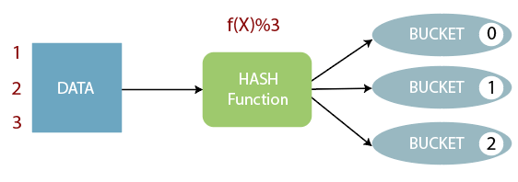
Bucketing in Hive
The bucketing in Hive is a data organizing technique. It is similar to partitioning in Hive with an added functionality that it divides large datasets into more manageable parts known as buckets. So, we can use bucketing in Hive when the implementation of partitioning becomes difficult. However, we can also divide partitions further in buckets.

Slide 17
Enable the bucketing by using the following command: -
hive> set hive.enforce.bucketing = true;
Create a bucketing table by using the following command: -
hive> create table emp_bucket(Id int, Name string , Salary float)
clustered by (Id) into 3 buckets
row format delimited
fields terminated by ',' ;

Slide 18
HiveQL - Operators
HiveQL operators facilitate to perform various arithmetic and relational operations.
Operators | Description
A + B | This is used to add A and B.
A - B | This is used to subtract B from A.
A * B | This is used to multiply A and B.
A / B | This is used to divide A and B and returns the quotient of the operands.
A % B | This returns the remainder of A / B.
A | B | This is used to determine the bitwise OR of A and B.
A & B | This is used to determine the bitwise AND of A and B.
A ^ B | This is used to determine the bitwise XOR of A and B.
~A | This is used to determine the bitwise NOT of A.
Operator | Description
A=B | It returns true if A equals B, otherwise false.
A <> B, A !=B | It returns null if A or B is null; true if A is not equal to B, otherwise false.
A<B | It returns null if A or B is null; true if A is less than B, otherwise false.
A>B | It returns null if A or B is null; true if A is greater than B, otherwise false.
A<=B | It returns null if A or B is null; true if A is less than or equal to B, otherwise false.
A>=B | It returns null if A or B is null; true if A is greater than or equal to B, otherwise false.
A IS NULL | It returns true if A evaluates to null, otherwise false.
A IS NOT NULL | It returns false if A evaluates to null, otherwise true.

Slide 19
hive> use hql;
hive> create table employee (Id int, Name string , Salary float)
row format delimited
fields terminated by ',' ;
hive> load data local inpath '/home/codegyani/hive/emp_data' into table employee;
hive> select * from employee;
hive> select id, name, salary + 50 from employee;
hive> select id, name, (salary * 10) /100 from employee;
hive> select * from employee where salary >= 25000;

Slide 20
HiveQL - Functions
Hive provides various in-built functions to perform mathematical and aggregate type operations.
Return type | Functions | Description
BIGINT | round(num) | It returns the BIGINT for the rounded value of DOUBLE num.
BIGINT | floor(num) | It returns the largest BIGINT that is less than or equal to num.
BIGINT | ceil(num), ceiling(DOUBLE num) | It returns the smallest BIGINT that is greater than or equal to num.
DOUBLE | exp(num) | It returns exponential of num.
DOUBLE | ln(num) | It returns the natural logarithm of num.
DOUBLE | log10(num) | It returns the base-10 logarithm of num.
DOUBLE | sqrt(num) | It returns the square root of num.
DOUBLE | abs(num) | It returns the absolute value of num.
DOUBLE | sin(d) | It returns the sin of num, in radians.
DOUBLE | asin(d) | It returns the arcsin of num, in radians.
DOUBLE | cos(d) | It returns the cosine of num, in radians.
DOUBLE | acos(d) | It returns the arccosine of num, in radians.
DOUBLE | tan(d) | It returns the tangent of num, in radians.
DOUBLE | atan(d) | It returns the arctangent of num, in radians.
Return Type | Operator | Description
BIGINT | count(*) | It returns the count of the number of rows present in the file.
DOUBLE | sum(col) | It returns the sum of values.
DOUBLE | sum(DISTINCT col) | It returns the sum of distinct values.
DOUBLE | avg(col) | It returns the average of values.
DOUBLE | avg(DISTINCT col) | It returns the average of distinct values.
DOUBLE | min(col) | It compares the values and returns the minimum one form it.
DOUBLE | max(col) | It compares the values and returns the maximum one form it.

Slide 21
hive> use hql;
hive> create table employee_data (Id int, Name string , Salary float)
row format delimited
fields terminated by ',' ;
hive> load data local inpath '/home/codegyani/hive/emp_details' into table employee_data;
hive> select * from employee_data;
hive> select Id, Name, sqrt(Salary) from employee_data ;
hive> select max(Salary) from employee_data;

Slide 22
Other built-in Functions in Hive
Return Type | Operator | Description
INT | length(str) | It returns the length of the string.
STRING | reverse(str) | It returns the string in reverse order.
STRING | concat(str1, str2, ...) | It returns the concatenation of two or more strings.
STRING | substr(str, start_index) | It returns the substring from the string based on the provided starting index.
STRING | substr(str, int start, int length) | It returns the substring from the string based on the provided starting index and length.
STRING | upper(str) | It returns the string in uppercase.
STRING | lower(str) | It returns the string in lowercase.
STRING | trim(str) | It returns the string by removing whitespaces from both the ends.
STRING | ltrim(str) | It returns the string by removing whitespaces from left-hand side.
STRING | rtrim(str) | It returns the string by removing whitespaces from right-hand side.
Select Id, upper(Name) from employee_data; select Id, upper(Name) from employee_data;

Slide 23
HiveQL - GROUP BY and HAVING Clause
The Hive Query Language provides GROUP BY and HAVING clauses that facilitate similar functionalities as in SQL
GROUP BY Clause
The HQL Group By clause is used to group the data from the multiple records based on one or more column. It is generally used in conjunction with the aggregate functions (like SUM, COUNT, MIN, MAX and AVG) to perform an aggregation over each group.
HAVING CLAUSE
The HQL HAVING clause is used with GROUP BY clause. Its purpose is to apply constraints on the group of data produced by GROUP BY clause. Thus, it always returns the data where the condition is TRUE.

Slide 24
hive> create table emp (Id int, Name string , Salary float, Department string)
row format delimited
fields terminated by ',' ;
hive> load data local inpath '/home/codegyani/hive/emp_data' into table emp;
Now, fetch the sum of employee salaries department wise by using the following command:
hive> select department, sum(salary) from emp group by department;

Slide 25
Let's fetch the sum of employee's salary based on department having sum >= 35000 by using the following command:
hive> select department, sum(salary) from emp group by department having sum(salary)>=35000;

Slide 26
HiveQL - ORDER BY and SORT BY Clause
By using HiveQL ORDER BY and SORT BY clause, we can apply sort on the column. It returns the result set either in ascending or descending order.
fetch the data in the descending order by using the following command:
hive> select * from emp order by salary desc;

Slide 27
HiveQL - SORT BY Clause
The HiveQL SORT BY clause is an alternative of ORDER BY clause. It orders the data within each reducer. Hence, it performs the local ordering, where each reducer's output is sorted separately. It may also give a partially ordered result.
Let's fetch the data in the descending order by using the following command:
hive> select * from emp sort by salary desc;

Slide 28
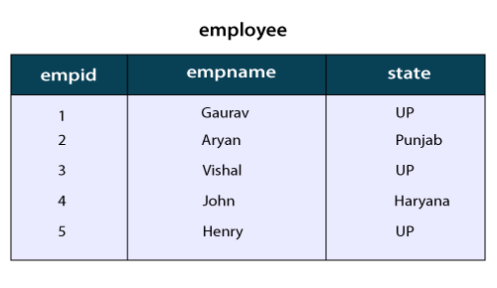
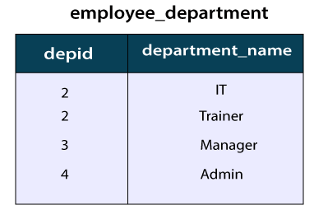
HiveQL - JOIN
The HiveQL Join clause is used to combine the data of two or more tables based on a related column between them. The various type of HiveQL joins are: -
Inner Join
Left Outer Join
Right Outer Join
Full Outer Join

Slide 29
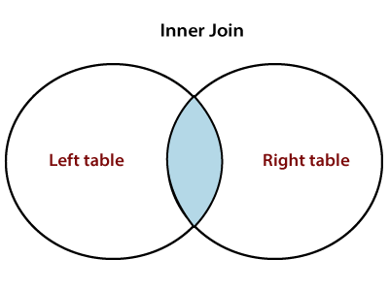
Inner Join in HiveQL
The HiveQL inner join is used to return the rows of multiple tables where the join condition satisfies. In other words, the join criteria find the match records in every table being joined.
hive>select e1.empname, e2.department_name from employee e1 join employee_department e2 on e1.empid= e2.depid;

Slide 30
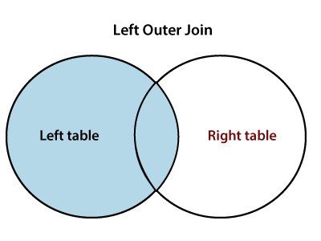
Left Outer Join in HiveQL
The HiveQL left outer join returns all the records from the left (first) table and only that records from the right (second) table where join criteria find the match.
hive> select e1.empname, e2.department_name from employee e1 left outer join employee_department e2 on e1.empid= e2.depid;

Slide 31
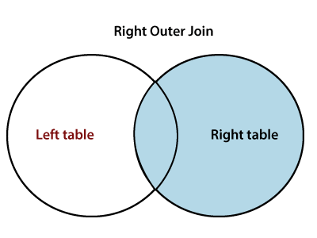
Right Outer Join in HiveQL
The HiveQL right outer join returns all the records from the right (second) table and only that records from the left (first) table where join criteria find the match.
hive> select e1.empname, e2.department_name from employee e1 right outer join employee_department e2 on e1.empid= e2.depid;

Slide 32
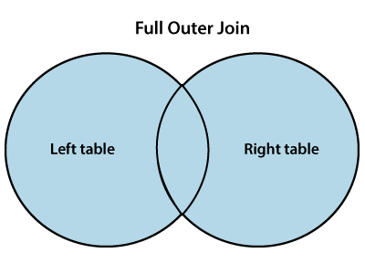
Full Outer Join
The HiveQL full outer join returns all the records from both the tables. It assigns Null for missing records in either table.
select e1.empname, e2.department_name from employee e1 full outer join employee_department e2 on e1.empid= e2.depid;

Slide 33



